Slide 1
Chart Templates
Select the well-designed chart on the left and right-click to “save as template”
Give the chart a descriptive name and save
Select the chart on the right, go to the Chart Design tab and select “Change Chart Type”
Scroll down to Templates, and apply your just saved template
Select the x-axis and change the maximum bounds manually to 300M to match the left chart

Slide 2
The World’s Highest Paid Athletes
Source: en.wikipedia.org/wiki/Forbes'_list_of_the_world's_highest-paid_athletes

Slide 3
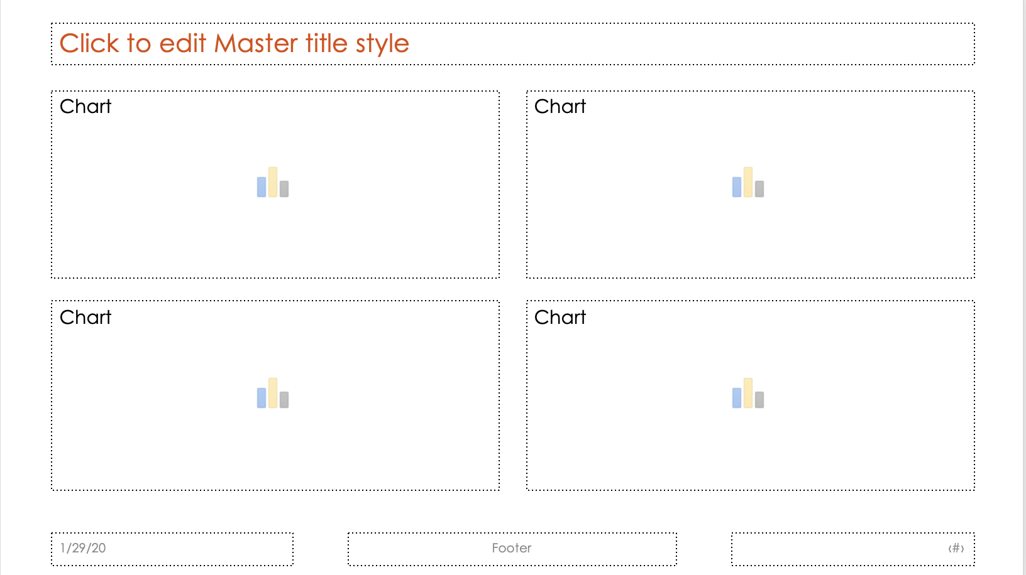
Chart Placeholders
Enter this file’s Master by going to View:
Slide Master and navigate to the 4th layout which is titled “Chart Placeholder Layout”
Insert 3 more chart placeholders by going to the Slide Master tab and selecting Insert Placeholder
Size and align the 4 placeholders to look like this:
Exit Master view and apply this new layout to the following slide
Experiment with cutting and pasting charts into the placeholders

Slide 4
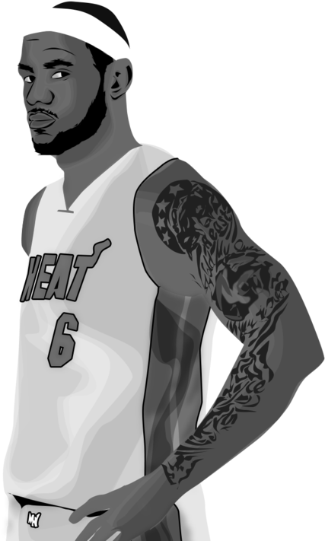
LeBron James is Not the Highest Paid Athlete
Source: en.wikipedia.org/wiki/Forbes'_list_of_the_world's_highest-paid_athletes

Slide 5
Proportional Shapes
(Calculator Method)
Download the Proportional Shape Calculator.xlsx from PresentYourStory.com/goodies
Enter the values into the Area column
Create PowerPoint circles or squares according to the vales generated (move decimal points over to make it easier)
Manually enter values into the shapes
Group all of your shapes together, resize and recolor as you like

Slide 6
Proportional Shapes
(SVG Method)
Insert a Bubble Chart onto an empty slide
(Insert Chart: X Y (Scatter): Bubble Chart…
Add (or delete) as many rows as you need
Enter your values in the “Size Column” and enter dummy values in the X & Y columns so that your sized circles do not overlap
Once your Bubble Chart has been created, add data labels if desired
Select the chart, right-click and Save as… an .SVG locally on your computer
Reimport the just-saved .SVG back onto your slide
Select the .SVG and Convert to Shape (Graphic Format tab)
Ungroup again and delete all items except your newly created circles
Design and format your proportional circles as desired

Slide 7
T-Shirts Sold by Color

Slide 8
[WORKSPACE]

Slide 9
FINISHED EXAMPLE
FINISHED EXAMPLE
T-Shirts Sold by Color
3,213
1,456
332

Slide 10
FINISHED EXAMPLE
T-Shirts Sold by Color
3,213
1,456
332

Slide 11




Total Box Office Grosses
Source: the-numbers.com/movies/franchise/Toy-Story#tab=summary

Slide 12
[WORKSPACE]

Slide 13
Chart Junk
Using everything you know about Chart Junk and “Non-data Ink,” redesign the following chart

Slide 14

Restaurant Group Revenue
Remove 3D
Remove Background color
Delete gridlines
Remove bevels
Remove gradients/shadows
Remove ticks horizontal
Custom number format
Delete X & Y axis titles
McKinsey Rule Title
Highlight summer
Put back in gridlines dashed gray
Revenue
Fiscal quarters by year
Notes:
[>=1000000] $#,##0,,"M";[>0] $#,##0,"K";General

Slide 15
[WORKSPACE]

Slide 16
FINISHED EXAMPLE
$15,753,826
Total
2000
2001
2002

Slide 17
Bullet Graphs
Select 2nd series (“Sales”) & set to Secondary Axis
Confirm that both axes have the same numerical scale (if not, manually change one to match the other)
Delete the new 2nd Y-axis
Select the 2nd series (“Sales”) and set the gap width to 500%
Don’t forget to direct label!

Slide 18
Notes:
Before

Slide 19
FINISHED EXAMPLE
PROJECTIONS
SALES

Slide 20
Slope Graphs
Change to line chart
Select Data: Switch Row/Column
Remove grid lines
Format X-axis: Axis Position On Tick Marks
Format X-axis: Remove axis line
Delete Y-axis
Delete Legend
Add value data labels to entire chart
Manually add ”series”
Manually move values to left of lines
OPTIONAL
Manually insert 2 vertical lines above years
Add markers to lines
Recolor lines

Slide 22
[WORKSPACE]

Slide 23
FINISHED EXAMPLE
Consumer Prices 2005-2015
Milk and Gas costs fell

Slide 24
Makeovers
Using everything you have learned, identify and write down what is problematic about the following charts
On paper, sketch out a better version of the chart or an entirely different visualization that you feel is more effective

Slide 27
